Slide 1
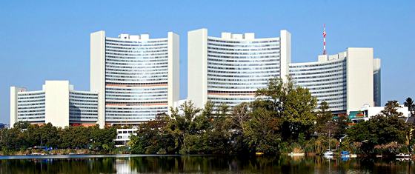
UNITED NATIONS ORGANISATION 24TH OCTOBER 1945 : FRANKLIN DELANO ROOSEVELT 193 MEMBERS: 2015 : 70TH ANNIVERSARY

Slide 3
PRINCIPAL ORGANS
THE GENERAL ASSEMBLY
THE SECURITY COUNCIL
THE ECONOMIC AND SOCIAL COUNCIL
THE INTERNATIONAL COURT OF JUSTICE
THE SECRETARIAT
THE TRUSTEESHIP COUNCIL

Slide 5
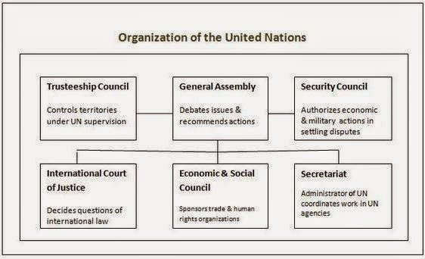

Slide 6
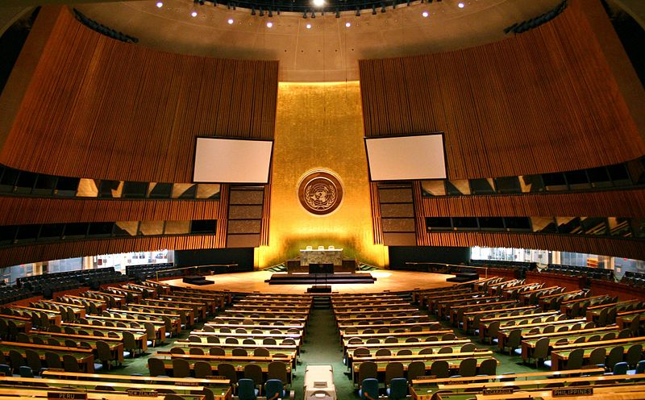
THE GENERAL ASSEMBLY

Slide 7
GENERAL ASSEMBLY
DELIBERATIVE, POLICYMAKING AND REPRESENTATIVE ORGAN
UNIVERSAL REPRESENTATION: 193
SEPTEMBER EVERY YEAR
PEACE AND SECURITY, ADMISSION OF NEW MEMBERS AND BUDGETARY MATTERS

Slide 8
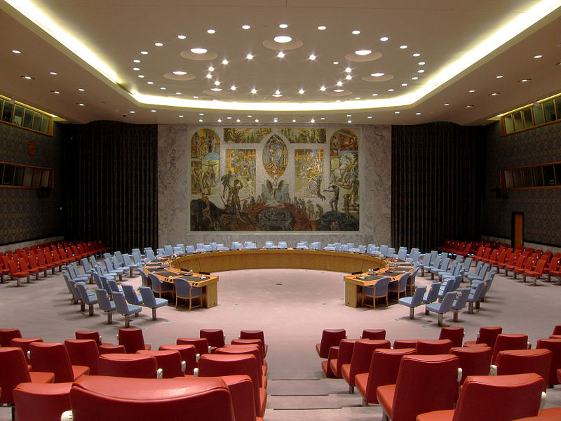
THE SECURITY COUNCIL

Slide 9
SECURITY COUNCIL
MAINTENANCE OF INTERNATIONAL PEACE AND SECURITY
15 MEMBERS : 5+10
CHINA, FRANCE, RUSSIA, THE UNITED KINGDOM, AND THE UNITED STATES (BIG 5)
DISPUTE: PARTIES: PEACE: SETTLEMENT

Slide 10
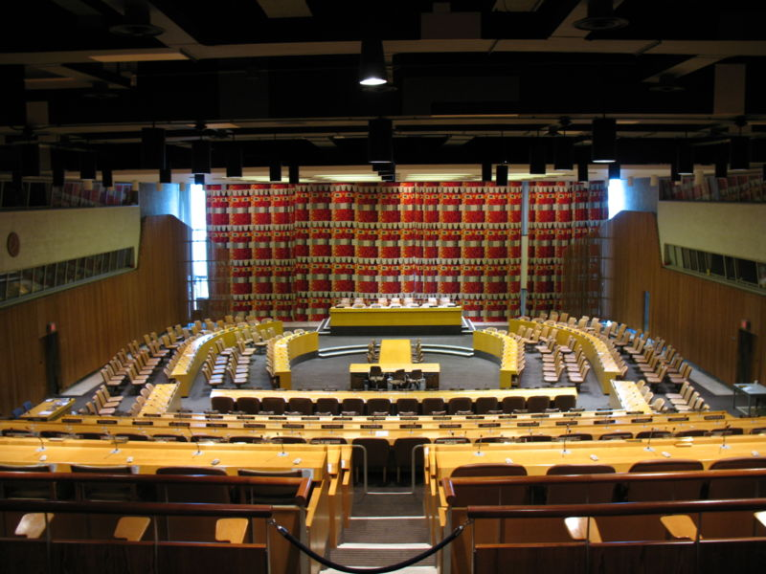
THE ECONOMIC AND SOCIAL COUNCIL

Slide 11
ECONOMIC AND SOCIAL COUNCIL
PRINCIPAL BODY FOR COORDINATION, POLICY REVIEW, POLICY DIALOGUE AND RECOMMENDATIONS ON ECONOMIC, SOCIAL AND ENVIRONMENTAL ISSUES, AS WELL AS IMPLEMENTATION OF INTERNATIONALLY AGREED DEVELOPMENT GOALS
54 MEMBERS, ELECTED BY THE GENERAL ASSEMBLY FOR OVERLAPPING THREE-YEAR TERM

Slide 12
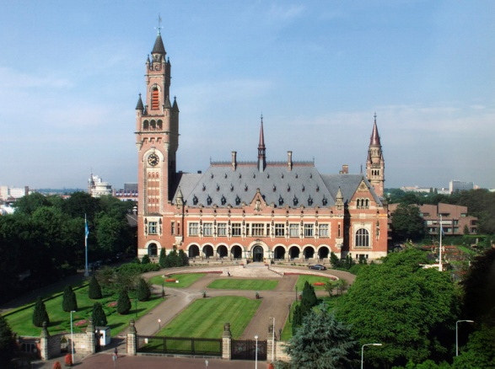
THE INTERNATIONAL COURT OF JUSTICE

Slide 13
INTERNATIONAL COURT OF JUSTICE
PEACE PALACE IN THE HAGUE (NETHERLANDS)
TO SETTLE, IN ACCORDANCE WITH INTERNATIONAL LAW, LEGAL DISPUTES SUBMITTED TO IT BY STATES AND TO GIVE ADVISORY OPINIONS ON LEGAL QUESTIONS REFERRED TO IT BY AUTHORIZED UNITED NATIONS ORGANS AND SPECIALIZED AGENCIES

Slide 14
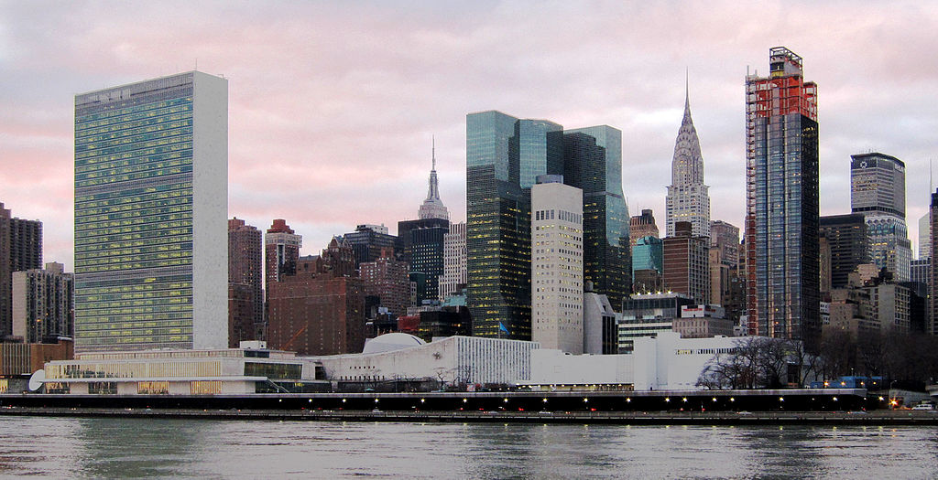
THE SECRETARIAT

Slide 15
THE SECRETARIAT
SECRETARY GENERAL : UN STAFF MEMBERS
FIVE YEAR TERM
CARRY OUT THE DAY-TO-DAY WORK OF THE UN AS MANDATED BY THE GENERAL ASSEMBLY AND THE ORGANIZATION'S OTHER PRINCIPAL ORGANS

Slide 16
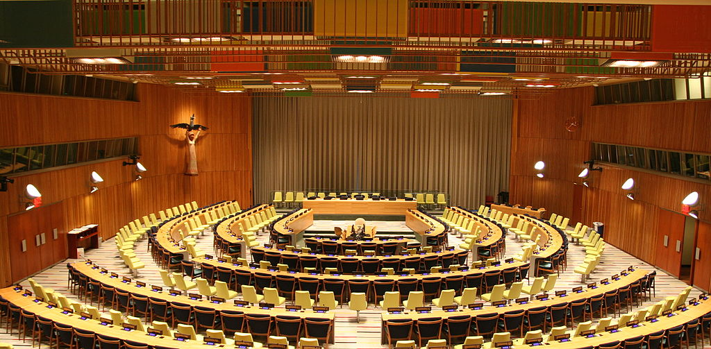
THE TRUSTEESHIP COUNCIL

Slide 17
TRUSTEESHIP COUNCIL
11 TRUST TERRITORIES
TO PREPARE THE TERRITORIES FOR SELF-GOVERNMENT AND INDEPENDENCE
1994, ALL TRUST TERRITORIES HAD ATTAINED SELF-GOVERNMENT OR INDEPENDENCE
SUSPENDED OPERATION ON 1 NOVEMBER 1994

Slide 18
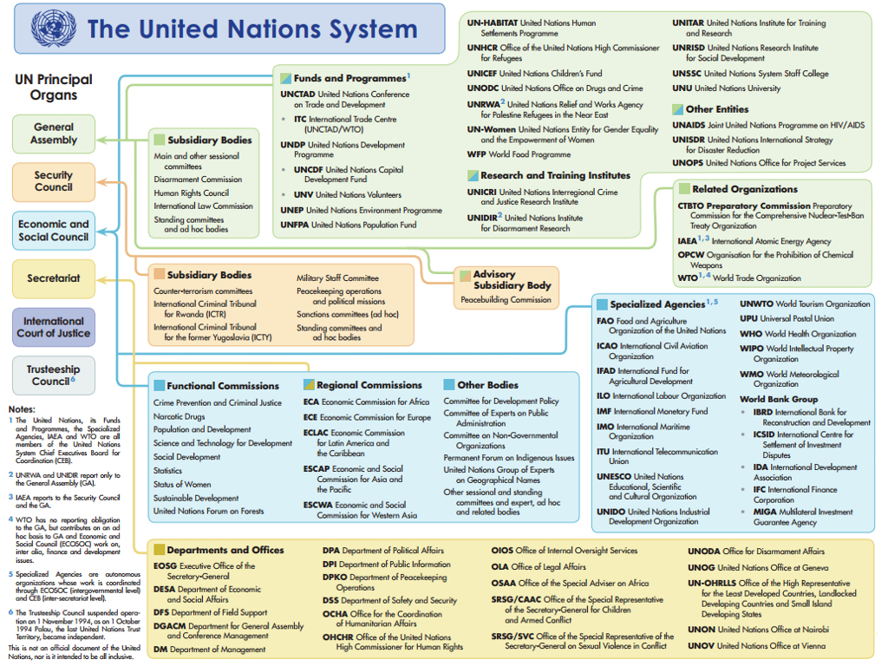

Slide 19
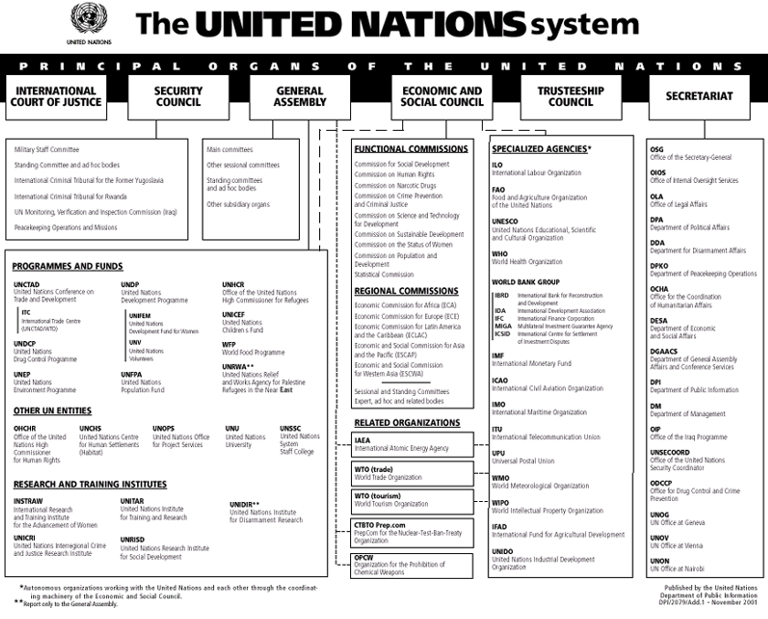

Slide 20
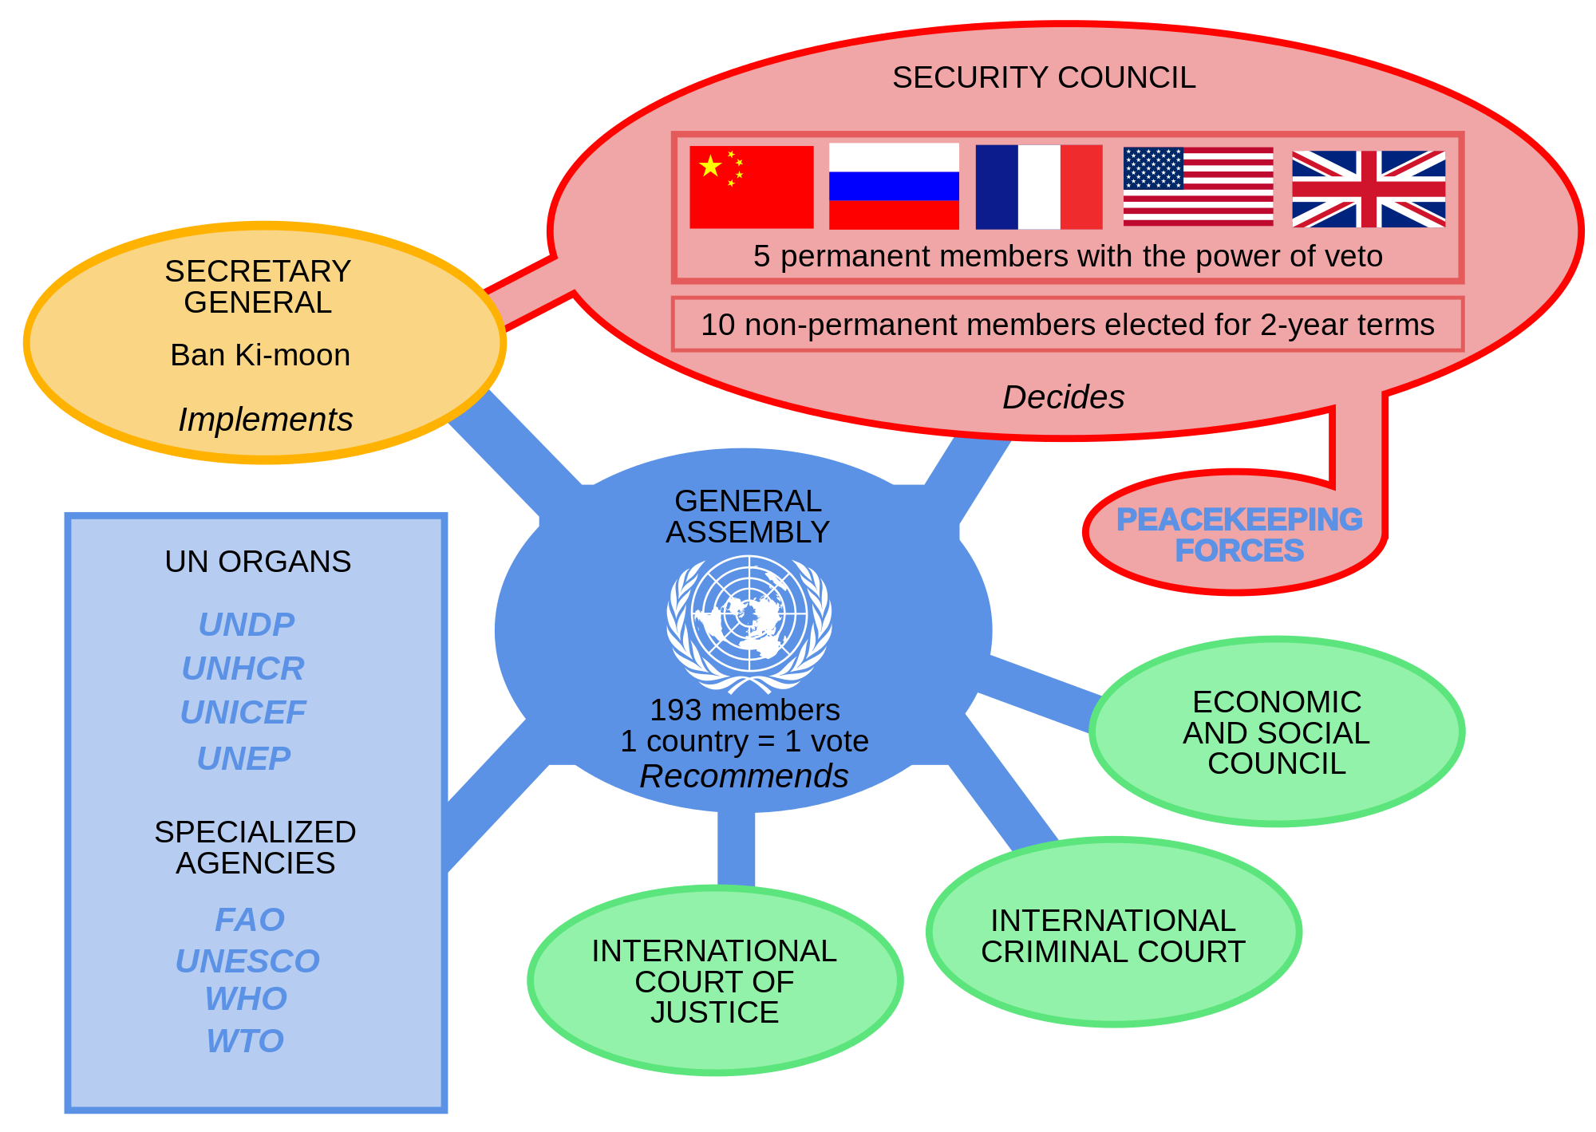

Slide 21
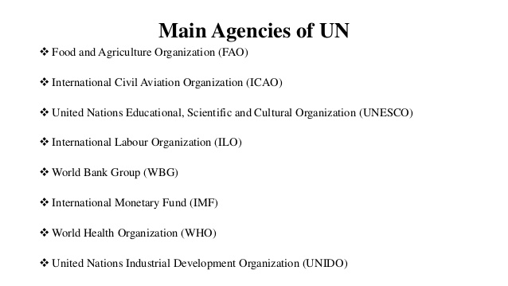

Slide 22
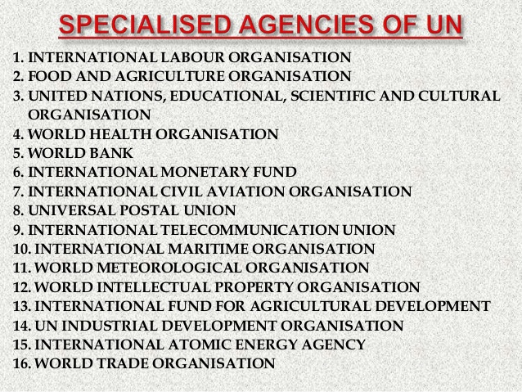

Slide 23
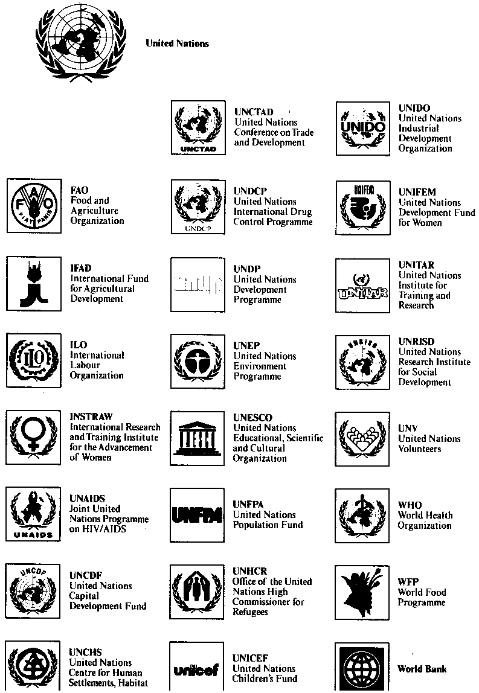

Slide 24
THE OFFICIAL LANGUAGES OF UN Arabic : Chinese : English : French : Russian : Spanish
THERE HAVE BEEN ONLY EIGHT SECRETARIES-GENERAL SINCE THE FOUNDING OF THE UN
TRYGVE LIE (NORWAY), 1946-1952
DAG HAMMARSKJÖLD (SWEDEN), 1953-1961
U THANT (BURMA, NOW MYANMAR), 1961-1971
KURT WALDHEIM (AUSTRIA), 1972-1981
JAVIER PÉREZ DE CUÉLLAR (PERU), 1982-1991
BOUTROS BOUTROS-GHALI (EGYPT), 1992-1996
KOFI ANNAN (GHANA), 1997-2006
BAN KI-MOON (REPUBLIC OF KOREA), SINCE 2007.

Slide 25
